Slide 1


Solar House Presentation
WVU Solar House
Faculty Advisors
Dr. Dimitris Korakakis
(Statler College of Engineering and Mineral Resources)
Eve Fox
(College of Creative Arts)
Chris Haddox
(Davis College of Agriculture, Natural Resources and Design )
Erica Lindsay
(Reed School of Journalism)
Dr. Clement Solomon
(Office of Sustainability)
Student Officers
Kenneth Hite – Statler
(President)
Kathleen Baker – Statler & CAC
(Vice-President of Creative Arts)
Brigid Cain - Statler
(Vice-President of Architecture)
Nick Ratcliff - Davis
(Vice-President of PR/Marketing)
Stephen Rebinski – B&E
(Vice-President of Finance/Treasurer)
Alex Roberts - Statler
(Vice-President of Engineering)
Brian Neff - Statler
(Secretary)
Advisor: Dr. Korakakis

Slide 2
Student List
Bryan Turek
Bryant Donato
Colby Ray Davis
Daniel Rose
Dana Amber Shearer
James Carrier
Edgardo Juan Antuna Esclusa
Mathew Joseph Myles
Hugh John Boylan
Robert kyle Stout
James A. Ratty
William Chiccirici
John William Wray IV
Cecilio Bezares
Kevin Michael Davis
Wentian Zhou
Wesley Wade Kidwell
Kenneth Ray Hite
Branden Samuel Bellanca
Laurel Lee Pell
Morgan Rose Trester
Amelia Kathryn Frye
Lorenzo Grieco
Sharrafti Aiman Kuzmar
Jessica Amber Seese
Andrea Michelle Argabright
Tara Noelle Dawson
Frank Christopher Ceglia Jr
Lauren Breanne Schiefelbein
Stallone Bruno Sabatier

Slide 3
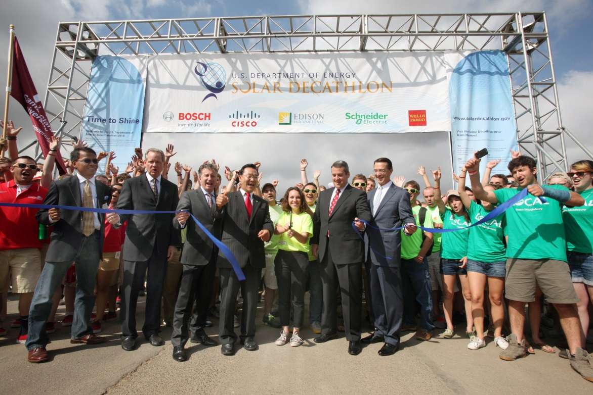
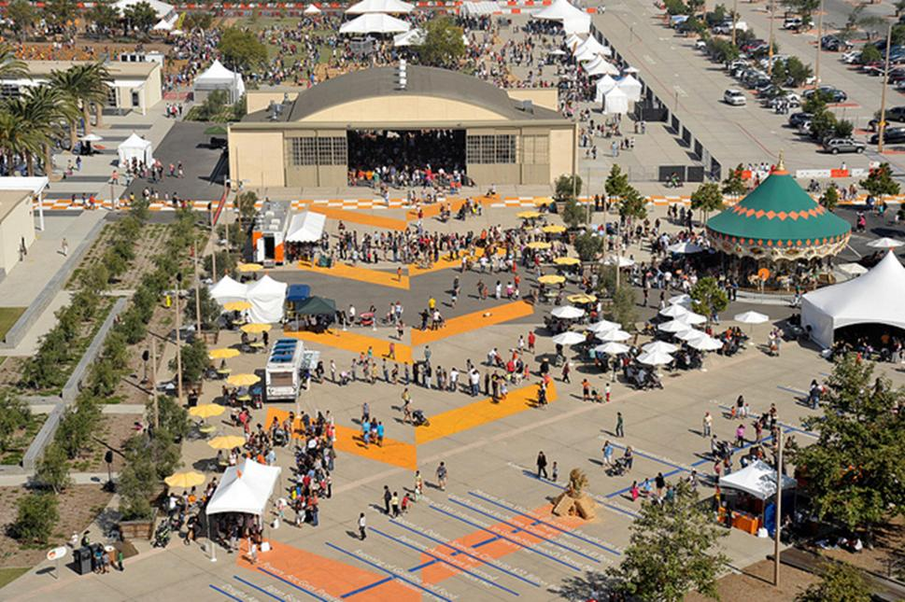
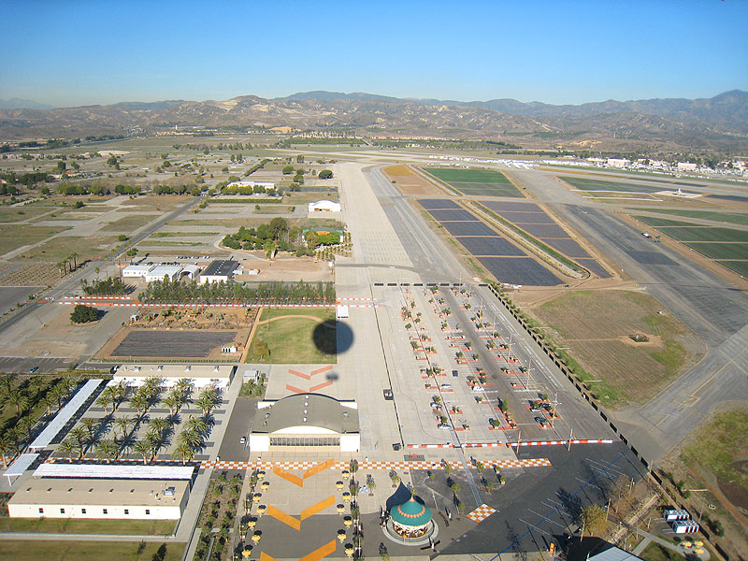
Competition Overview
Department of Energy
Design, build, and operate a solar-powered house
International
$250,000 budget on the home
$100,000 grant from the US Department of Energy
600 - 1,000 ft²
Orange County Park, California

Slide 4
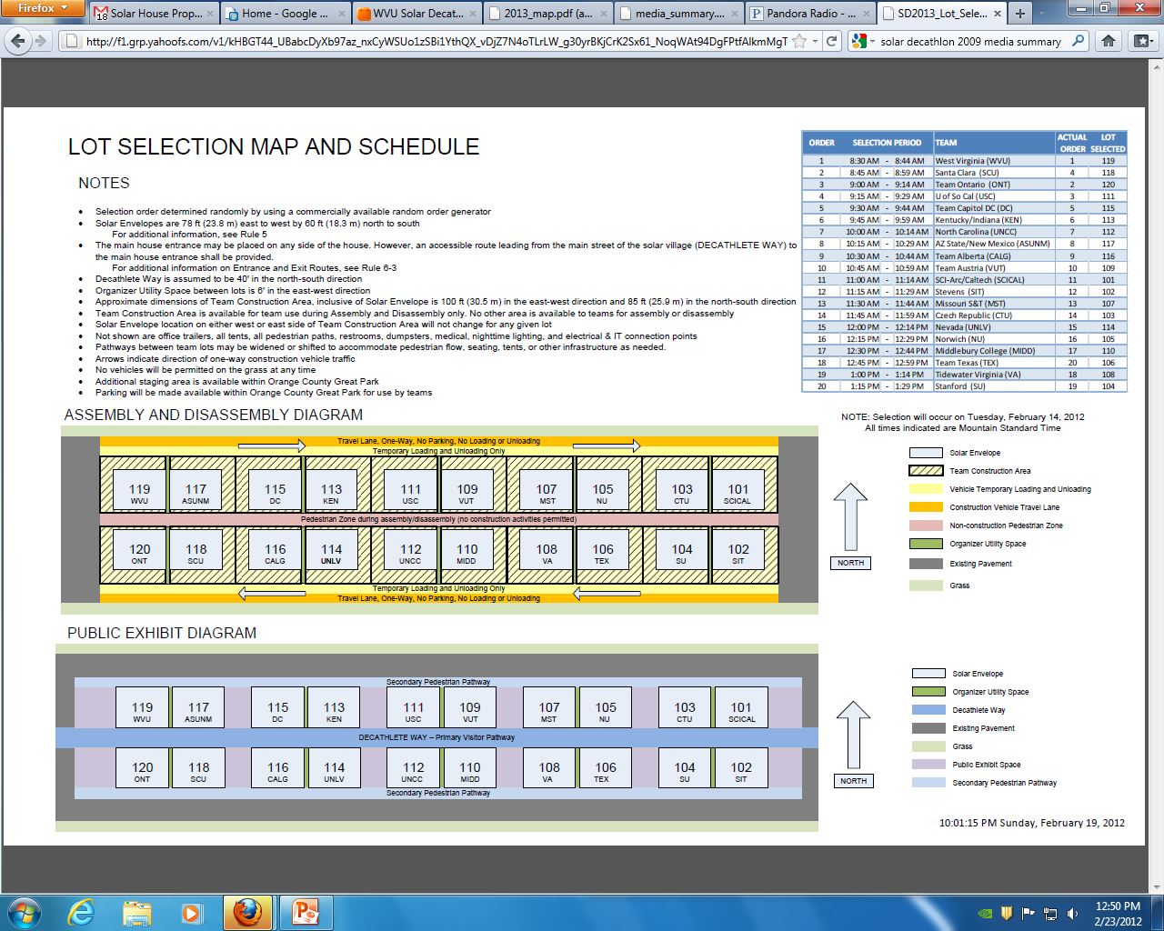
Competition Site
20 teams
  4 International
  11 New
  9 Returning
Lot 119
Upper Left Corner Spot
Closest to

Slide 5
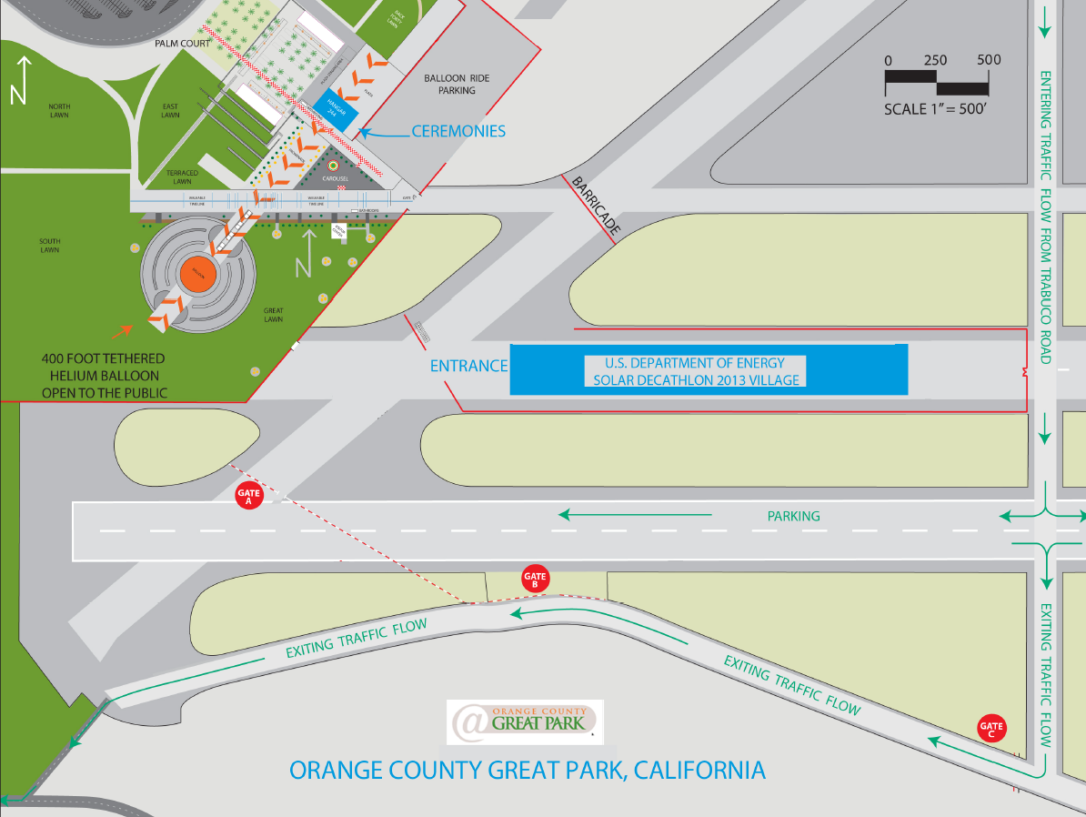
Competition Site

Slide 6
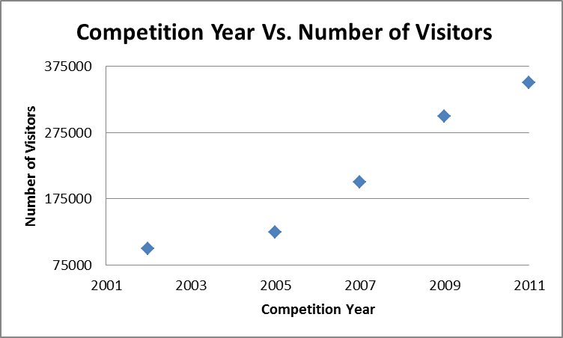
Exposure
Since 2002:
  92 collegiate teams
  15,000 collegiate lives affected
  Workforce development
2011:
  >350,000 house visits in 10 days
  Millions of readers/viewers worldwide

Slide 7
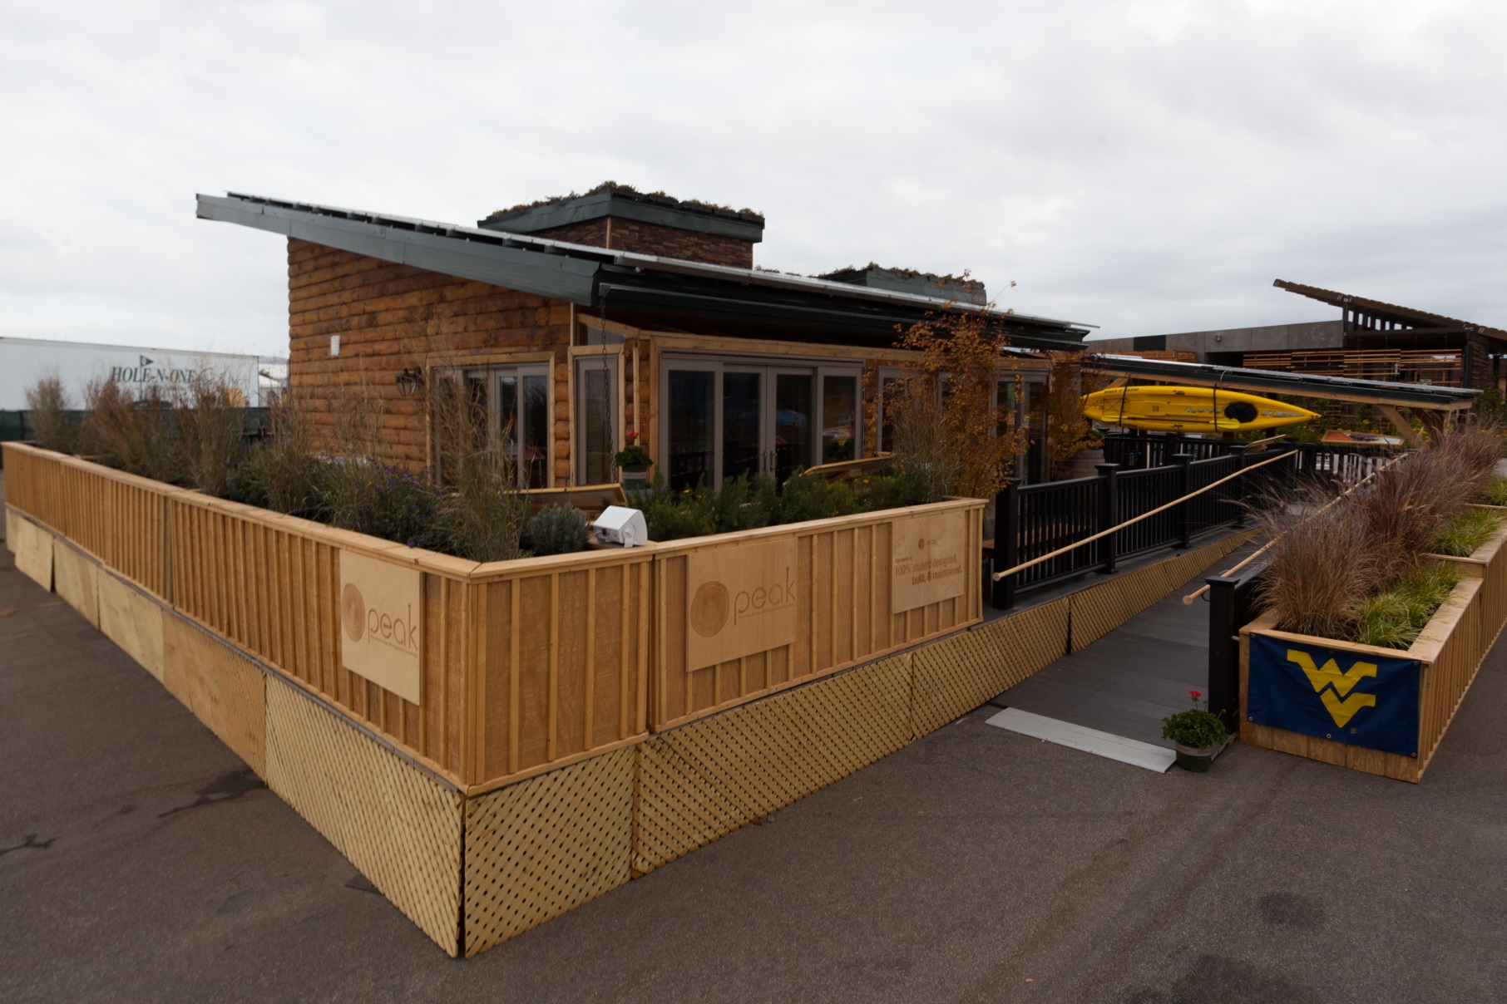
PEAK

Slide 8
PEAK Floorplan

Slide 9
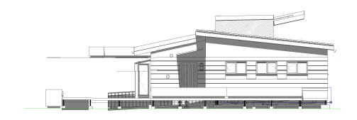
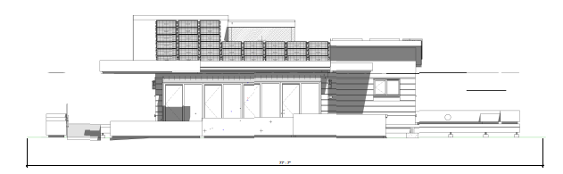
Creating PEAK

Slide 10
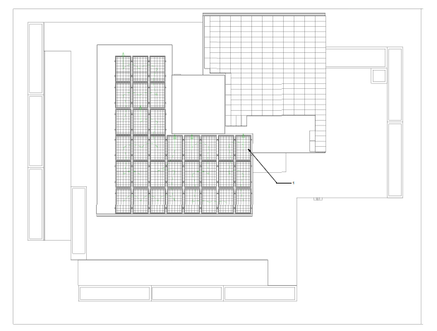
Creating PEAK

Slide 11

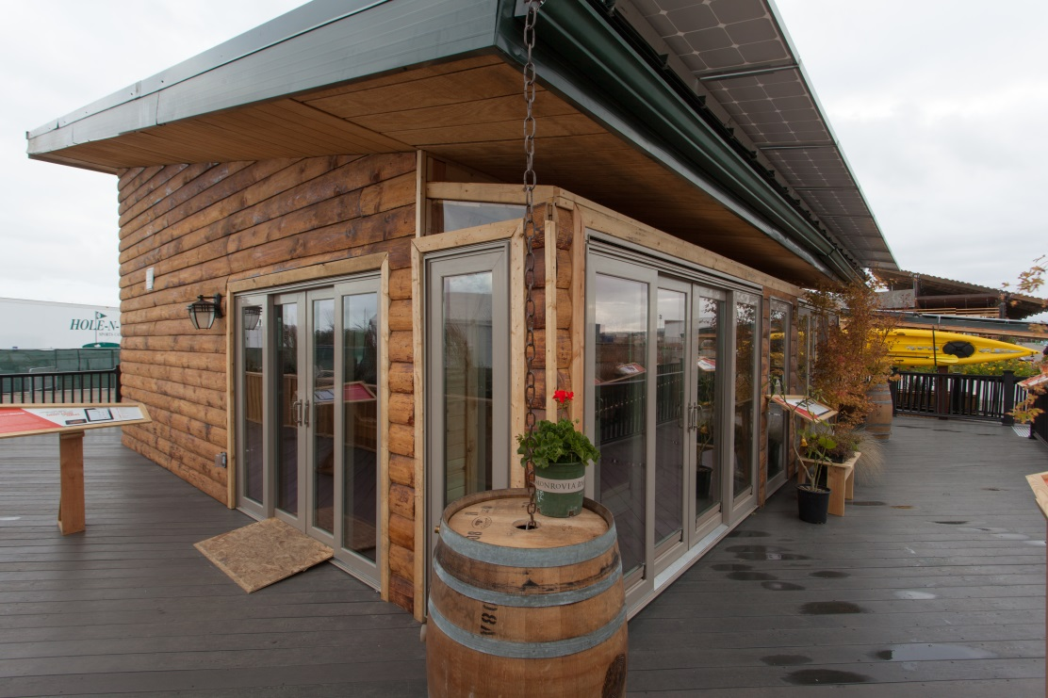
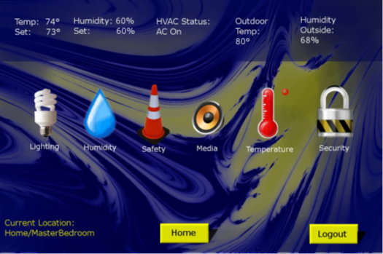
Key Innovations
Smart-home
International Collaboration
Strong Undergraduate Participation
Log Cabin

Slide 12
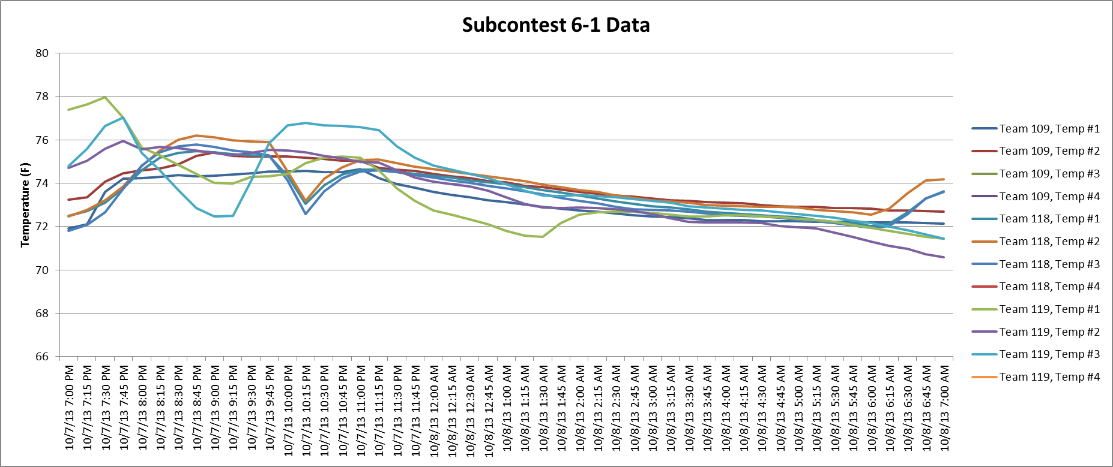
Temperature Monitoring

Slide 13
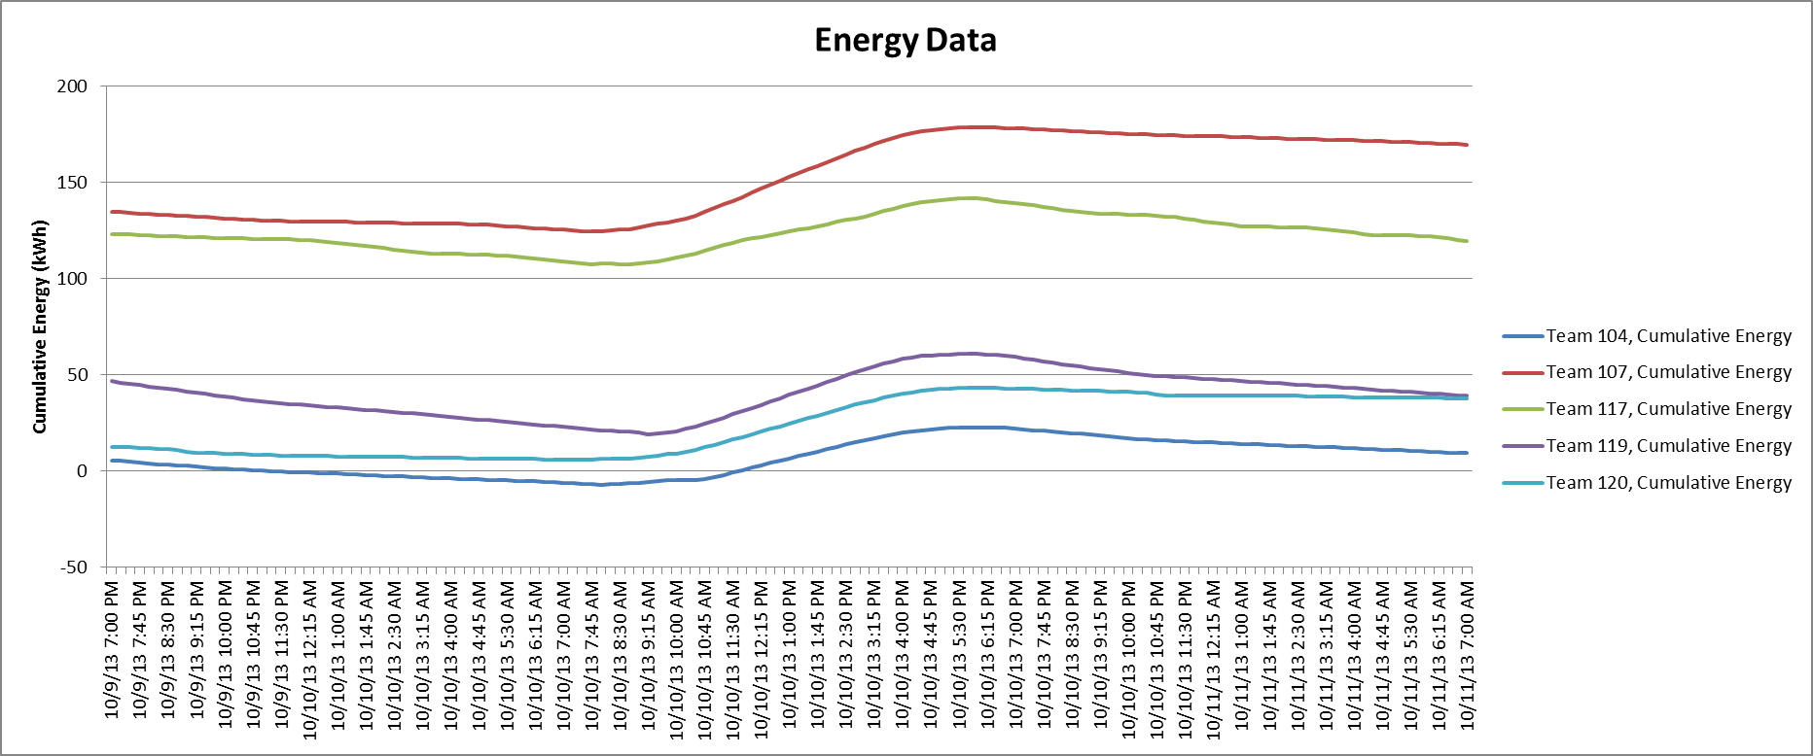
Energy production and dissipation

Slide 14














Sponsors

Slide 15
Faculty Advisors
Principle Investigator:
    Dimitris Korakakis -Statler
Acting Co-Principle Investigators:
    Stefano Cordiner -UTV
    Jim Ebel -SoJ
    Eve Faulkes -CCA
    Chris Haddox -Davis
    Clement Solomon -OoS

Slide 16
Special Thanks to:
West Virginia University
Admins:
Gene Cilento
Russ Dean
Diana Martinelli
Warren Myers
Daniel Robison
Brian Woerner
University of Rome Tor
Vergata Faculty:
Stefano Cordiner
Viccenzo Mulone
West Virginia University Faculty and Staff:
Bonnie Burchinal
David DeVallance
Mary Dillon
Scott Fleming
Karen Grimm
Wesley Kimble
Beth Loflin
Bryan Martin
Chris Randall
Nicole Riggleman
Jake Stump
Cynthia Tanner

