Slide 1
Science, Technology, And Research SYMPOSIUM
October 22, 2013

Slide 2
Forward-Looking Statements
This presentation contains forward-looking statements and information. These forward-looking statements, which in many instances can be identified by words like “could,” “may,” “will,” “should,” “expects,” “plans,” “project,” “anticipates,” “believes,” “planned,” “proposed,” “potential,” and other comparable words, regarding future or contemplated results, performance, transactions, or events, are based on MarkWest Energy Partners, L.P. (“MarkWest” and the “Partnership”) current information, expectations and beliefs, concerning future developments and their potential effects on MarkWest. Although MarkWest believes that the expectations reflected in the forward-looking statements are reasonable, it can give no assurance that such expectations will prove to be correct, and actual results, performance, distributions, events or transactions could vary significantly from those expressed or implied in such statements and are subject to a number of uncertainties and risks.
Among the factors that could cause results to differ materially are those risks discussed in the periodic reports filed with the SEC, including MarkWest’s Annual Report on Form 10-K for the year ended December 31, 2012 and its Quarterly Report on Form 10-Q for the quarter ended June 30, 2013. You are urged to carefully review and consider the cautionary statements and other disclosures, including those under the heading “Risk Factors,” made in those documents. If any of the uncertainties or risks develop into actual events or occurrences, or if underlying assumptions prove incorrect, it could cause actual results to vary significantly from those expressed in the presentation, and MarkWest’s business, financial condition, or results of operations could be materially adversely affected. Key uncertainties and risks that may directly affect MarkWest’s performance, future growth, results of operations, and financial condition, include, but are not limited to:
  Fluctuations and volatility of natural gas, NGL products, and oil prices;
  A reduction in natural gas or refinery off-gas production which MarkWest gathers, transports, processes, and/or fractionates;
  A reduction in the demand for the products MarkWest produces and sells;
  Financial credit risks / failure of customers to satisfy payment or other obligations under MarkWest’s contracts;
  Effects of MarkWest’s debt and other financial obligations, access to capital, or its future financial or operational flexibility or liquidity;
  Construction, procurement, and regulatory risks in our development projects;
  Hurricanes, fires, and other natural and accidental events impacting MarkWest’s operations, and adequate insurance coverage;
  Terrorist attacks directed at MarkWest facilities or related facilities;
  Changes in and impacts of laws and regulations affecting MarkWest operations and risk management strategy; and
  Failure to integrate recent or future acquisitions.

Slide 3
Non-GAAP Measures
Distributable Cash Flow, Adjusted EBITDA, and Net Operating Margin are not measures of performance calculated in accordance with GAAP, and should not be considered separately from or as a substitute for net income, income from operations, or cash flow as reflected in our financial statements. The GAAP measure most directly comparable to Distributable Cash Flow and Adjusted EBITDA is net income (loss). The GAAP measure most directly comparable to Net Operating Margin is income (loss) from operations.
In general, we define DCF as net income (loss) adjusted for (i) depreciation, amortization, impairment, and other non-cash expense; (ii) amortization of deferred financing costs and discount; (iii) loss on redemption of debt net of current tax benefit; (iv) non-cash (earnings) loss from unconsolidated affiliates; (v) distributions from (contributions to) unconsolidated affiliates (net of affiliate growth capital expenditures); (vi) non-cash compensation expense; (vii) non-cash derivative activity; (viii) losses (gains) on the disposal of property, plant, and equipment (PP&E) and unconsolidated affiliates; (ix) provision for deferred income taxes; (x) cash adjustments for non-controlling interest in consolidated subsidiaries; (xi) revenue deferral adjustment; (xii) losses (gains) relating to other miscellaneous non-cash amounts affecting net income for the period; and (xiii) maintenance capital expenditures, net of joint venture partner contributions. We define Adjusted EBITDA as net income (loss) adjusted for (i) depreciation, amortization, impairment, and other non-cash expense; (ii) interest expense; (iii) amortization of deferred financing costs; (iv) loss on redemption of debt; (v) losses (gains) on the disposal of PP&E and unconsolidated affiliates; (vi) non-cash derivative activity; (vii) non-cash compensation expense; (viii) provision for income taxes; (ix) adjustments for cash flow from unconsolidated affiliates; (x) adjustment related to non-guarantor, consolidated subsidiaries; and (xi) losses (gains) relating to other miscellaneous non-cash amounts affecting net income for the period. We generally define Operating Income before Items Not Allocated to Segments as (i) revenue, excluding derivative gains and losses and adjusted for certain revenue deferral adjustments less; (ii) purchased product costs, excluding derivative gains and losses less; (iii) facility expenses, adjusted for certain non-cash items not allocated to segments and certain interest payments allocable to the segments less; ( iv) the portion allocable to non-controlling interests.
Distributable Cash Flow is a financial performance measure used by management as a key component in the determination of cash distributions paid to unitholders. We believe distributable cash flow is an important financial measure for unitholders as an indicator of cash return on investment and to evaluate whether the Partnership is generating sufficient cash flow to support quarterly distributions. In addition, distributable cash flow is commonly used by the investment community because the market value of publicly traded partnerships is based, in part, on distributable cash flow and cash distributions paid to unitholders.
Adjusted EBITDA is a financial performance measure used by management, industry analysts, investors, lenders, and rating agencies to assess the financial performance and operating results of the Partnership’s ongoing business operations. Additionally, we believe Adjusted EBITDA provides useful information to investors for trending, analyzing, and benchmarking our operating results from period to period as compared to other companies that may have different financing and capital structures.
Net Operating Margin is a financial performance measure used by management and investors to evaluate the underlying baseline operating performance of our contractual arrangements. Management also uses Net Operating Margin to evaluate the Partnership’s financial performance for purposes of planning and forecasting.
Please see the Appendix for reconciliations of Distributable Cash Flow, Adjusted EBITDA, and Net Operating Margin to the most directly comparable GAAP measure.

Slide 4
MarkWest Overview

Slide 5
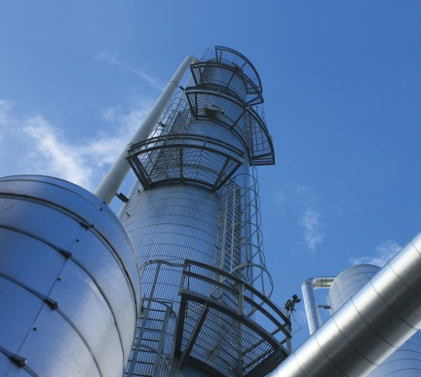
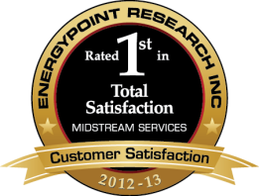
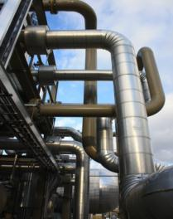
Key Investment Considerations
Quarterly Distribution
Growth of 236%
Since IPO
High-Quality,
Diversified Assets
Proven Growth and
Customer Satisfaction
Substantial
Growth Opportunities
Strong Financial Profile
Leading presence in major shale plays including Marcellus, Utica, Huron/Berea, Woodford , Haynesville and Granite Wash formation
Largest processor in the Marcellus Shale
Largest fractionator in the Northeast
Over $8 billion of organic growth and acquisitions since IPO
Over $5 billion invested in Marcellus and Utica since 2008
Received top ranking in EnergyPoint’s 2013 Midstream Customer Satisfaction survey
No incentive distribution rights, which drives a lower cost of capital
Distributions have increased by 236% (12% CAGR) since IPO
    Growing fee-based margin to over 70% for full-year 2014
2013 growth capital forecast of $1.5 to $1.8 billion
23 major processing and fractionation projects under construction
Long-term agreements with over 25 major producer customers
Established relationships & joint venture partners

Slide 6









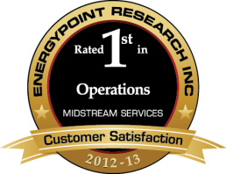






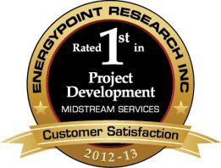


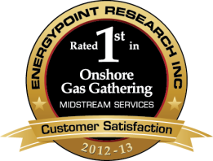










Growth Driven By Customer Satisfaction
MarkWest has received the top rating in three of the last four
EnergyPoint Research surveys

Slide 7
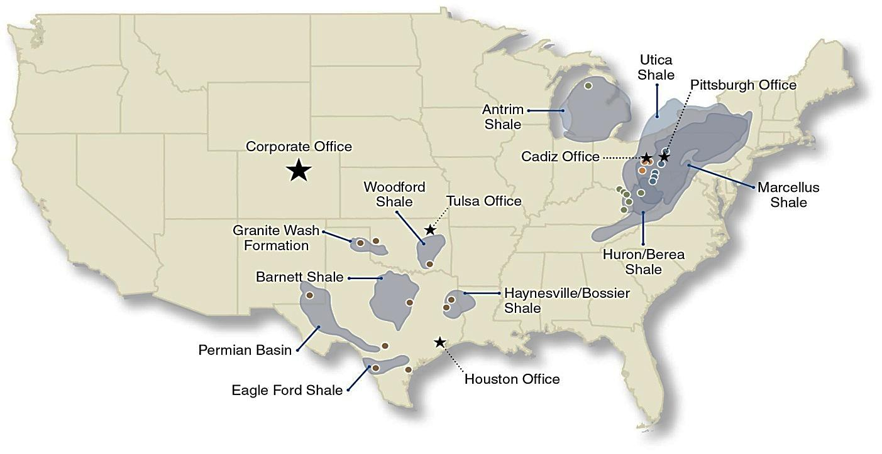
MarkWest Assets: Expansion and Diversification
Liberty | Largest processor and fractionator in the Marcellus Shale with over 1.6 Bcf/d of processing capacity and 98,000 Bbl/d of fractionation capacity. Growing to 3.6 Bcf/d of processing capacity and 232,000 Bbl/d of fractionation capacity
Utica | Developing a leading position in the southern core of the Utica Shale with 185 MMcf/d of processing capacity. Growing to over 900 MMcf/d of processing capacity and nearly 140,000 Bbl/d of fractionation capacity by the end of 2014
Northeast | Largest processor and fractionator in the southern Appalachian Basin
Southwest | Best-in-class midstream services in the Granite Wash, Haynesville, Woodford and Eagle Ford Shales and have over 1.6 Bcf/d of gathering capacity and 817 MMcf/d of processing capacity

Slide 8
Marcellus and Utica: 16 Major Projects Complete…
…22 Major projects under construction
Crawford
KEYSTONE COMPLEX
Bluestone I & Sarsen I – 90 MMcf/d – Complete
Bluestone II – 120 MMcf/d – 2Q14
Bluestone III – 200 MMcf/d – TBD
De-ethanization – 10,000 Bbl/d – 1Q14
C3+ Fractionation – 10,000 Bbl/d –1Q14
Trumbull
Venango
HOUSTON COMPLEX
Houston I, II & III – 355 MMcf/d – Complete
Houston IV – 200 MMcf/d – 2015
C3+ Fractionation – 60,000 Bbl/d – Complete
De-ethanization – 38,000 Bbl/d – Complete
Mercer
Portage
Clarion
Medina
Summit
HOPEDALE FRACTIONATOR
C3+ Fractionation – 60,000 Bbl/d – 1Q14
Mahoning
Ohio
Lawrence
Butler
Wayne
Stark
Armstrong
CADIZ COMPLEX
Cadiz I & Refrig – 185 MMcf/d – Complete
Cadiz II – 200 MMcf/d – 3Q14
De-ethanization – 40,000 Bbl/d – 1Q14
Columbiana
Beaver
MAJORSVILLE COMPLEX
Majorsville I - III – 470 MMcf/d – Complete
Majorsville IV – 200 MMcf/d – 1Q14
Majorsville V – 200 MMcf/d – 4Q13
Majorsville VI – 200 MMcf/d – 2016
De-ethanization I – 38,000 Bbl/d – 4Q13
De-ethanization II – 38,000 Bbl/d – TBD
Holmes
Carroll
Hancock
Tuscarawas
Allegheny
Harrison
Jefferson
Westmoreland
Coshocton
SENECA COMPLEX
Seneca I – 200 MMcf/d – 4Q13
Seneca II – 200 MMcf/d – 4Q13
Seneca III – 200 MMcf/d – 2Q14
De-ethanization – 38,000 Bbl/d – 4Q14
Brooke
Muskingum
Guernsey
Belmont
Ohio
Washington
Fayette
MOBLEY COMPLEX
Mobley I & II – 320 MMcf/d – Complete
Mobley III – 200 MMcf/d – 4Q13
Mobley IV – 200 MMcf/d – 1Q15
Marshall
Greene
Noble
Monroe
Monongalia
Morgan
Wetzel
MWE Gathering Area
Washington
MWE Utica Counties
Tyler
Marion
Preston
SHERWOOD COMPLEX
Sherwood I & II – 400 MMcf/d – Complete
Sherwood III – 200 MMcf/d – 4Q13
Sherwood IV – 200 MMcf/d – 2Q14
De-ethanization – 38,000 Bbl/d – 1Q15
MWE Marcellus Counties
MWE Plants
Rich Utica
Pleasants
Taylor
ATEX Express Pipeline
Wood
Harrison
West Virginia
TEPPCO Product Pipeline
Ritchie
Doddridge
Mariner Projects
Rich Marcellus
Barbour
MWE NGL Pipelines

Slide 9
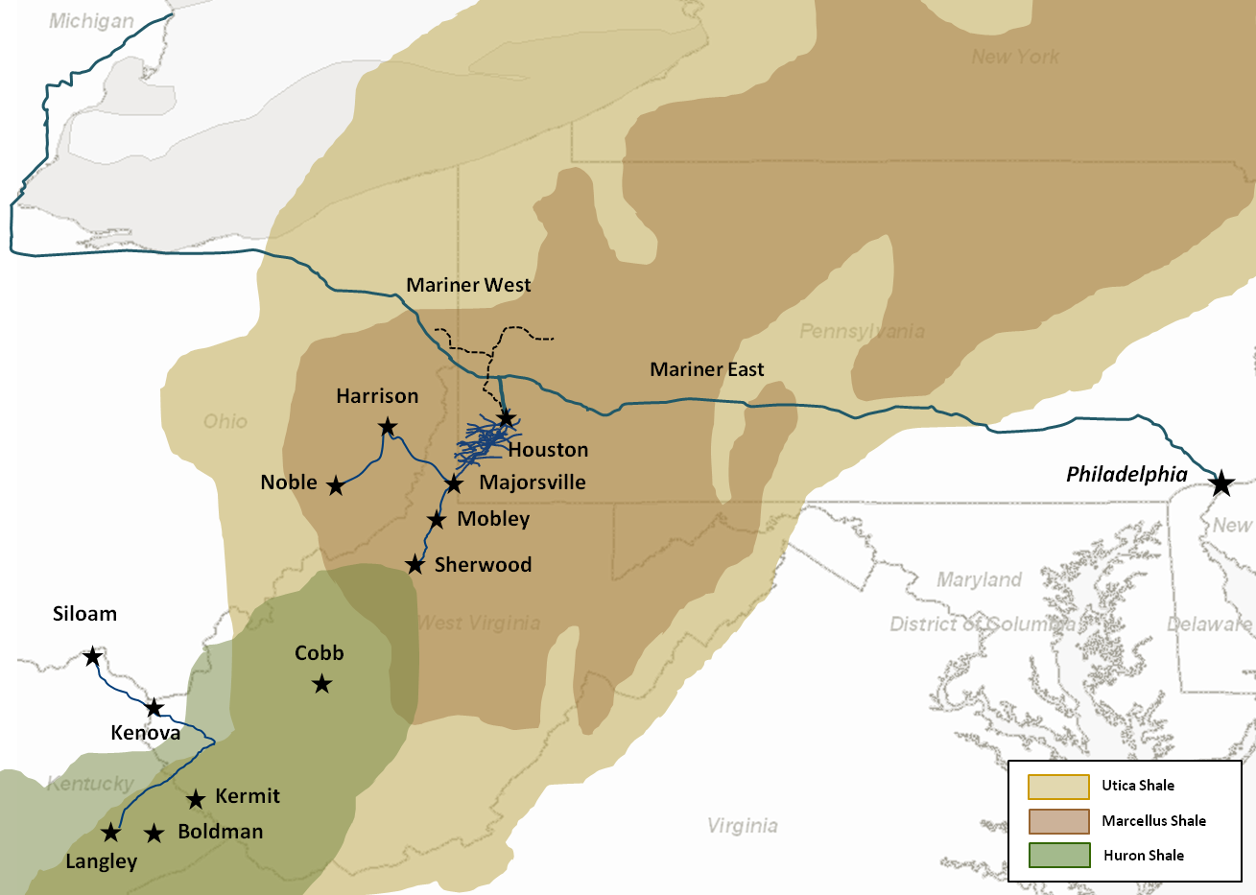
MarkWest is the Midstream Leader in Northeast Shales
Utica Shale
Marcellus Shale
Huron Shale

Slide 10
Comparison of N.E. Interstate Pipeline Gas Quality Spec’s.

Slide 11
U.S. Shale Plays are Driving Natural Gas Supply
U.S. dry natural gas production (trillion cubic feet per year)
EIA data concludes that natural gas supply will increase by approximately 25 percent by 2030 driven primarily by increased demand by power generation and transportation sectors. Essentially all of the supply increase will be met by shale gas production
By 2030 shale gas production will increase by 65% and will account for 48% of total U.S. natural gas supply
Resource plays will continue to drive midstream investment for decades to come and MarkWest will continue to focus our investments in these areas
2013
48%
36%
24%
22%
1%
4%
6%
6%
7%
11%
5%
15%
7%
8%
Source: U.S. Energy Information Administration, Annual Energy Outlook 2013 Early Release

Slide 12
U.S. Shale Play Volume Growth
The Marcellus Shale is the largest producing gas field in North America
Billion cubic feet per day
Marcellus
Haynesville
Barnett
Eagle Ford
Woodford
Bakken
Sources: LCI Energy Insight gross withdrawal estimates as of January 2013 and converted to dry gas estimates with EIA-calculated average gross-to-dry shrinkage factors by state and/or shale play.

Slide 13
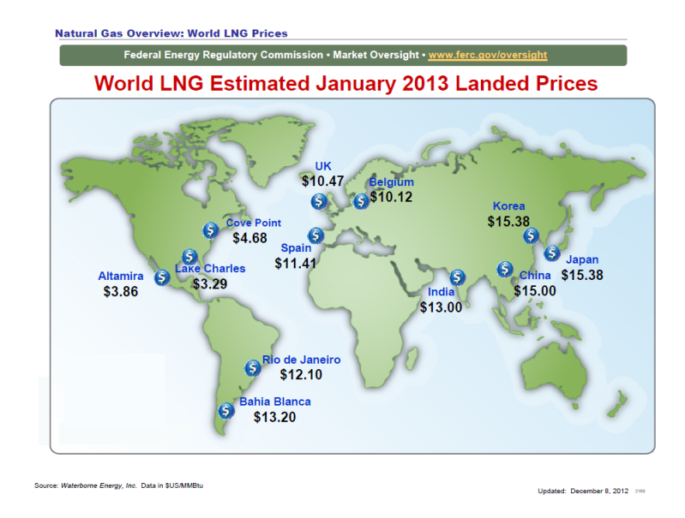
World LNG Prices-January 2013

Slide 15
Mt. Belvieu NGL Prices-$/gal.

Slide 16
Domestic FRAC Spread
 |  | Price |  |  | Price | Weighed
Mix | Product | Cnts/gal | $/gal | BTU/Gal | $/MMBTU | Average
42% | Ethane | 28.630 | $ 0.29 | 66,500 | 4.31 | $ 1.81
28% | Propane | 94.380 | $ 0.94 | 90,900 | 10.38 | $ 2.91
11% | Normal Butane | 126.060 | $ 1.26 | 102,930 | 12.25 | $ 1.35
6% | Isobutane | 126.560 | $ 1.27 | 98,935 | 12.79 | $ 0.77
13% | Natural Gasoline | 205.000 | $ 2.05 | 110,100 | 18.62 | $ 2.42
100% |  |  |  |  |  | $ 9.25
 |  |  |  | Henry Hub Natural Gas |  | $ 4.13
 |  |  |  | Frac Spread |  | $ 5.12

Slide 17
International FRAC Spread*
 |  | Price |  |  | Price | Weighed
Mix | Product | Cnts/gal | $/gal | BTU/Gal | $/MMBTU | Average
42% | Ethane | 28.630 | $ 0.29 | 66,500 | 4.31 | $ 1.81
28% | Propane | 139.380 | $ 1.39 | 90,900 | 15.33 | $ 4.29
11% | Normal Butane | 168.060 | $ 1.68 | 102,930 | 16.33 | $ 1.80
6% | Isobutane | 168.560 | $ 1.69 | 98,935 | 17.04 | $ 1.02
13% | Natural Gasoline | 205.000 | $ 2.05 | 110,100 | 18.62 | $ 2.42
100% |  |  |  |  |  | $ 11.34
 |  |  |  | Henry Hub Natural Gas |  | $ 4.13
 |  |  |  | Frac Spread |  | $ 7.21
Avg. NW Europe, Japanese Propane and Butane Prices

Slide 18
Enormous Growth in Liberty Processing Volumes
Liberty volumes to double in 2013 and grow significantly in the future
Million cubic feet per day

Slide 19
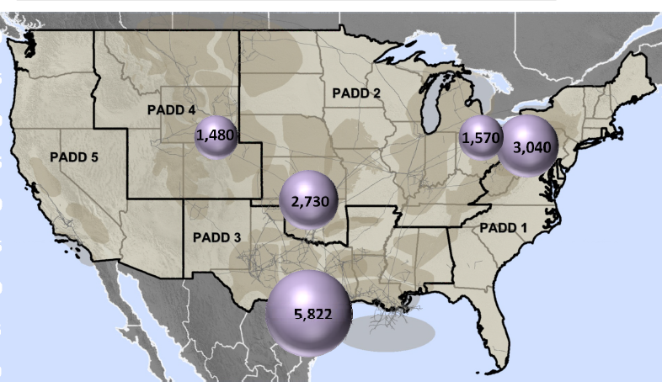
U.S. Processing Capacity Additions
One-third of US new processing capacity is in Northeast

Slide 20
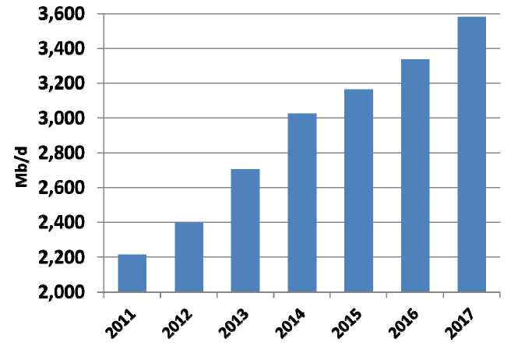
U.S. NGL Market Growth
Domestic NGL Production to increase 50% by 2017

Slide 21
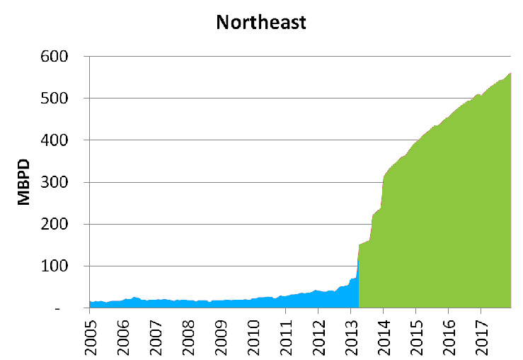
Northeast NGL Production: Set for Liftoff
NGL production forecasted to increase six fold by 2015

Slide 22

Marcellus & Utica C2 Potential
Ethane Opportunity is Significant
MarkWest NE Processing Capacity MMcf/d
MarkWest NE C2 Production Potential (MBbl/d)
22

Slide 23
Marcellus & Utica Propane Plus Potential
Propane and heavier opportunity is very significant
MarkWest NE Processing Capacity MMcf/d
MarkWest NE C3+ Production Potential (MBbl/d)
23

Slide 24
1515 Arapahoe Street
Tower 1, Suite 1600
Denver, Colorado 80202
Phone: 303-925-9200
Investor Relations: 866-858-0482
Email: investorrelations@markwest.com
Website: www.markwest.com

