Slide 1
Heating Things Up: Energy’s Evolution In Response To Climate Change
STaR Symposium 2013
The Evolution of Energy: From Scarcity to Abundance
October 22, 2013
Notes:
Welcome
I am using the term climate change as an all encompassing term – political, economic, physical, technological
Here to provide some context

Slide 2
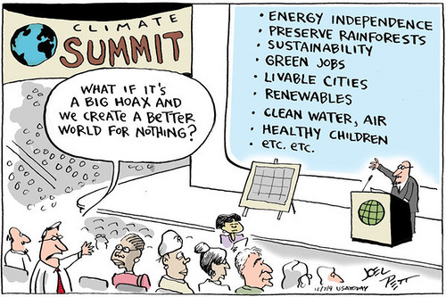
Notes:
This slide looks at climate from an energy independence and sustainability perspective
Our naysayer here says “What if it’s a big hoax?”
Say we create a better world – for what purpose? 1. Society benefits and 2. Future generations benefit

Slide 3
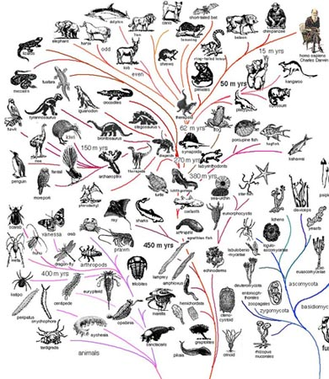
Evolution and Extinction
http://wiki.dickinson.edu/images/6/63/Evolution.Jpg
Notes:
I was thinking about this panel and realized that the biological principles of evolution and extinction is a great analogy for the evolution of energy (this Symposium’s theme)
We talk about evolution and the comings and goings of species
Age of dinosaurs
Impact of meteors hitting the Earth, wiping out the dinosaurs
People worry about species extinction (especially in the tropics)

Slide 4
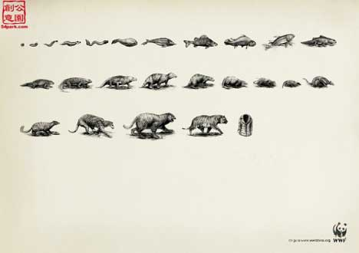
http://theinspirationroom.com/daily/print/2008/1/wwf-tiger-extinction.jpg
Notes:
How some species evolve and some go extinct. As you can see from this pixelated advertisement from the World Wildlife Funds, it shows a bacteria eventually evolving into a mink, which then becomes a mink coat for some human. This shows that we as humans play a role in how some species are treated, utilized, and either supported to kick to the wayside.
So how does this relate to the theme of energy?

Slide 5
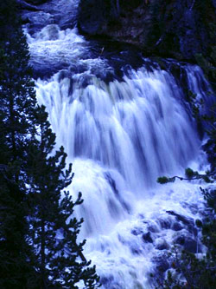
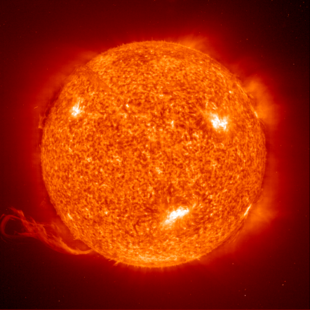
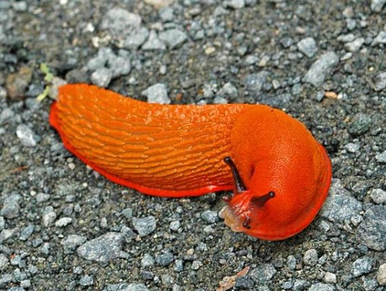
Wind
Water
Solar
Coal
Notes:
To follow the evolutionary theme, I’ve used animal species to personify each source of energy.
Wind, water, solar, coal

Slide 6
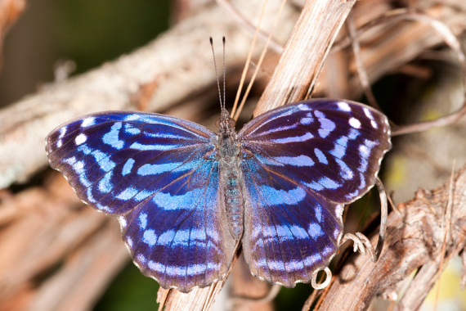
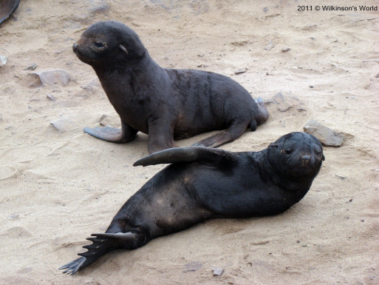
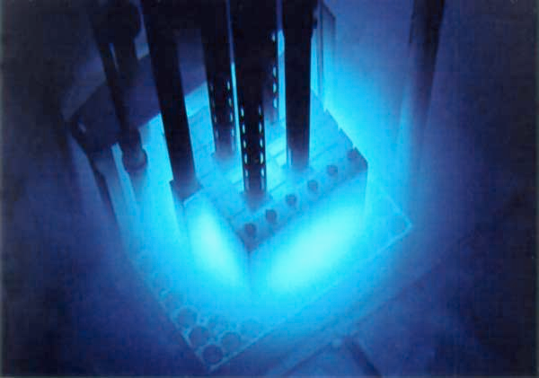
Natural Gas
Oil
Nuclear
Biomass
Notes:
As well as natural gas, oil, nuclear, biomass
Just as many factors play into the survival of animal species, the same is true for sources of energy.

Slide 7
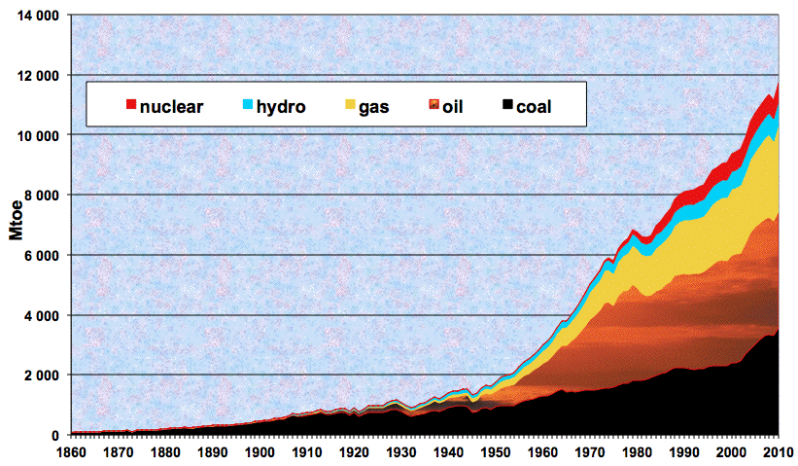
Evolution of the world energy consumption (excluding biomass) since 1860.
Sources : Schilling & Al. (1977), IEA (2002), Observatoire de l'Energie (1997). (http://www.manicore.com/anglais/documentation_a/articles_a/palace_may2001.html)
Notes:
Looking at this graph from 1860-1960, for 100 years, it’s apparent that the primary energy source was coal. From 1950-1960, alternative energy sources entered the picture, such as oil, gas, hydro and a little bit of nuclear.
Solar, wind and biomass were all insignificant in these early years, and although missing on this graph are new “species” coming onto the scene.
With little evolution for 100 years, let’s look from 1960-2010, in just 50 years. [Remove box]
Staying true to my evolution theme, this latter half of the graph illustrates the proliferation of species. By 2010, oil and gas are about the same, natural gas has continued to grow, and hydro/nuclear have stayed more or less consistent.
We’ve had no extinctions – just evolution.

Slide 8
History
Policy
Technology
Sustainability
Notes:
Energy sustainability, energy policy, energy technology, and energy use all play a role in the evolution of energy.
How will they affect the comings and goings of the species of energy?
Our panel today beings with Kevin Law, West Virginia’s state climatologist
I asked him to focus remarks on the historical evolution of energy as well as the forecasts for going into the future about the lifespan of each of these species. Who evolves? Who survives? Who dies off? Mini-evolutions… (how species of energy will change and evolve over 50 years)
The three other panelists will share their area of expertise in the context of energy use on Planet Earth: policy, technology and sustainability.
[Share bios of each panelist prior to their presentation]

