Slide 1
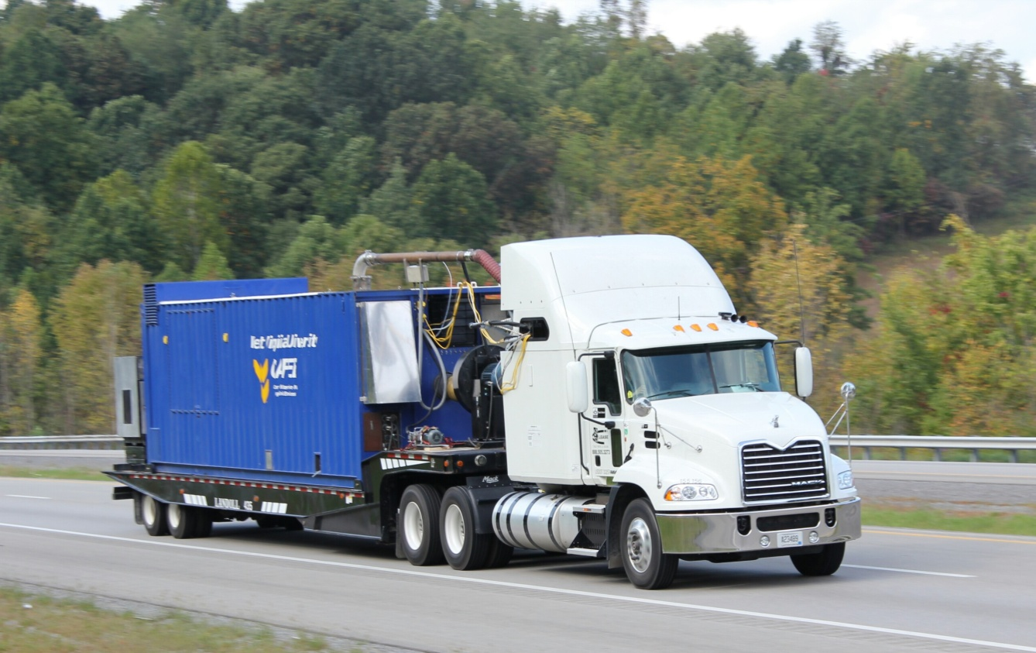
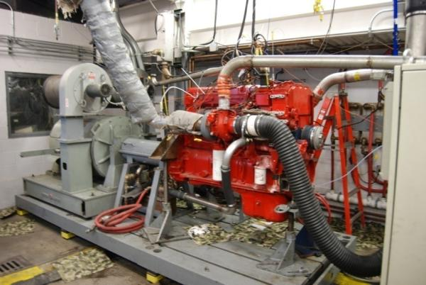
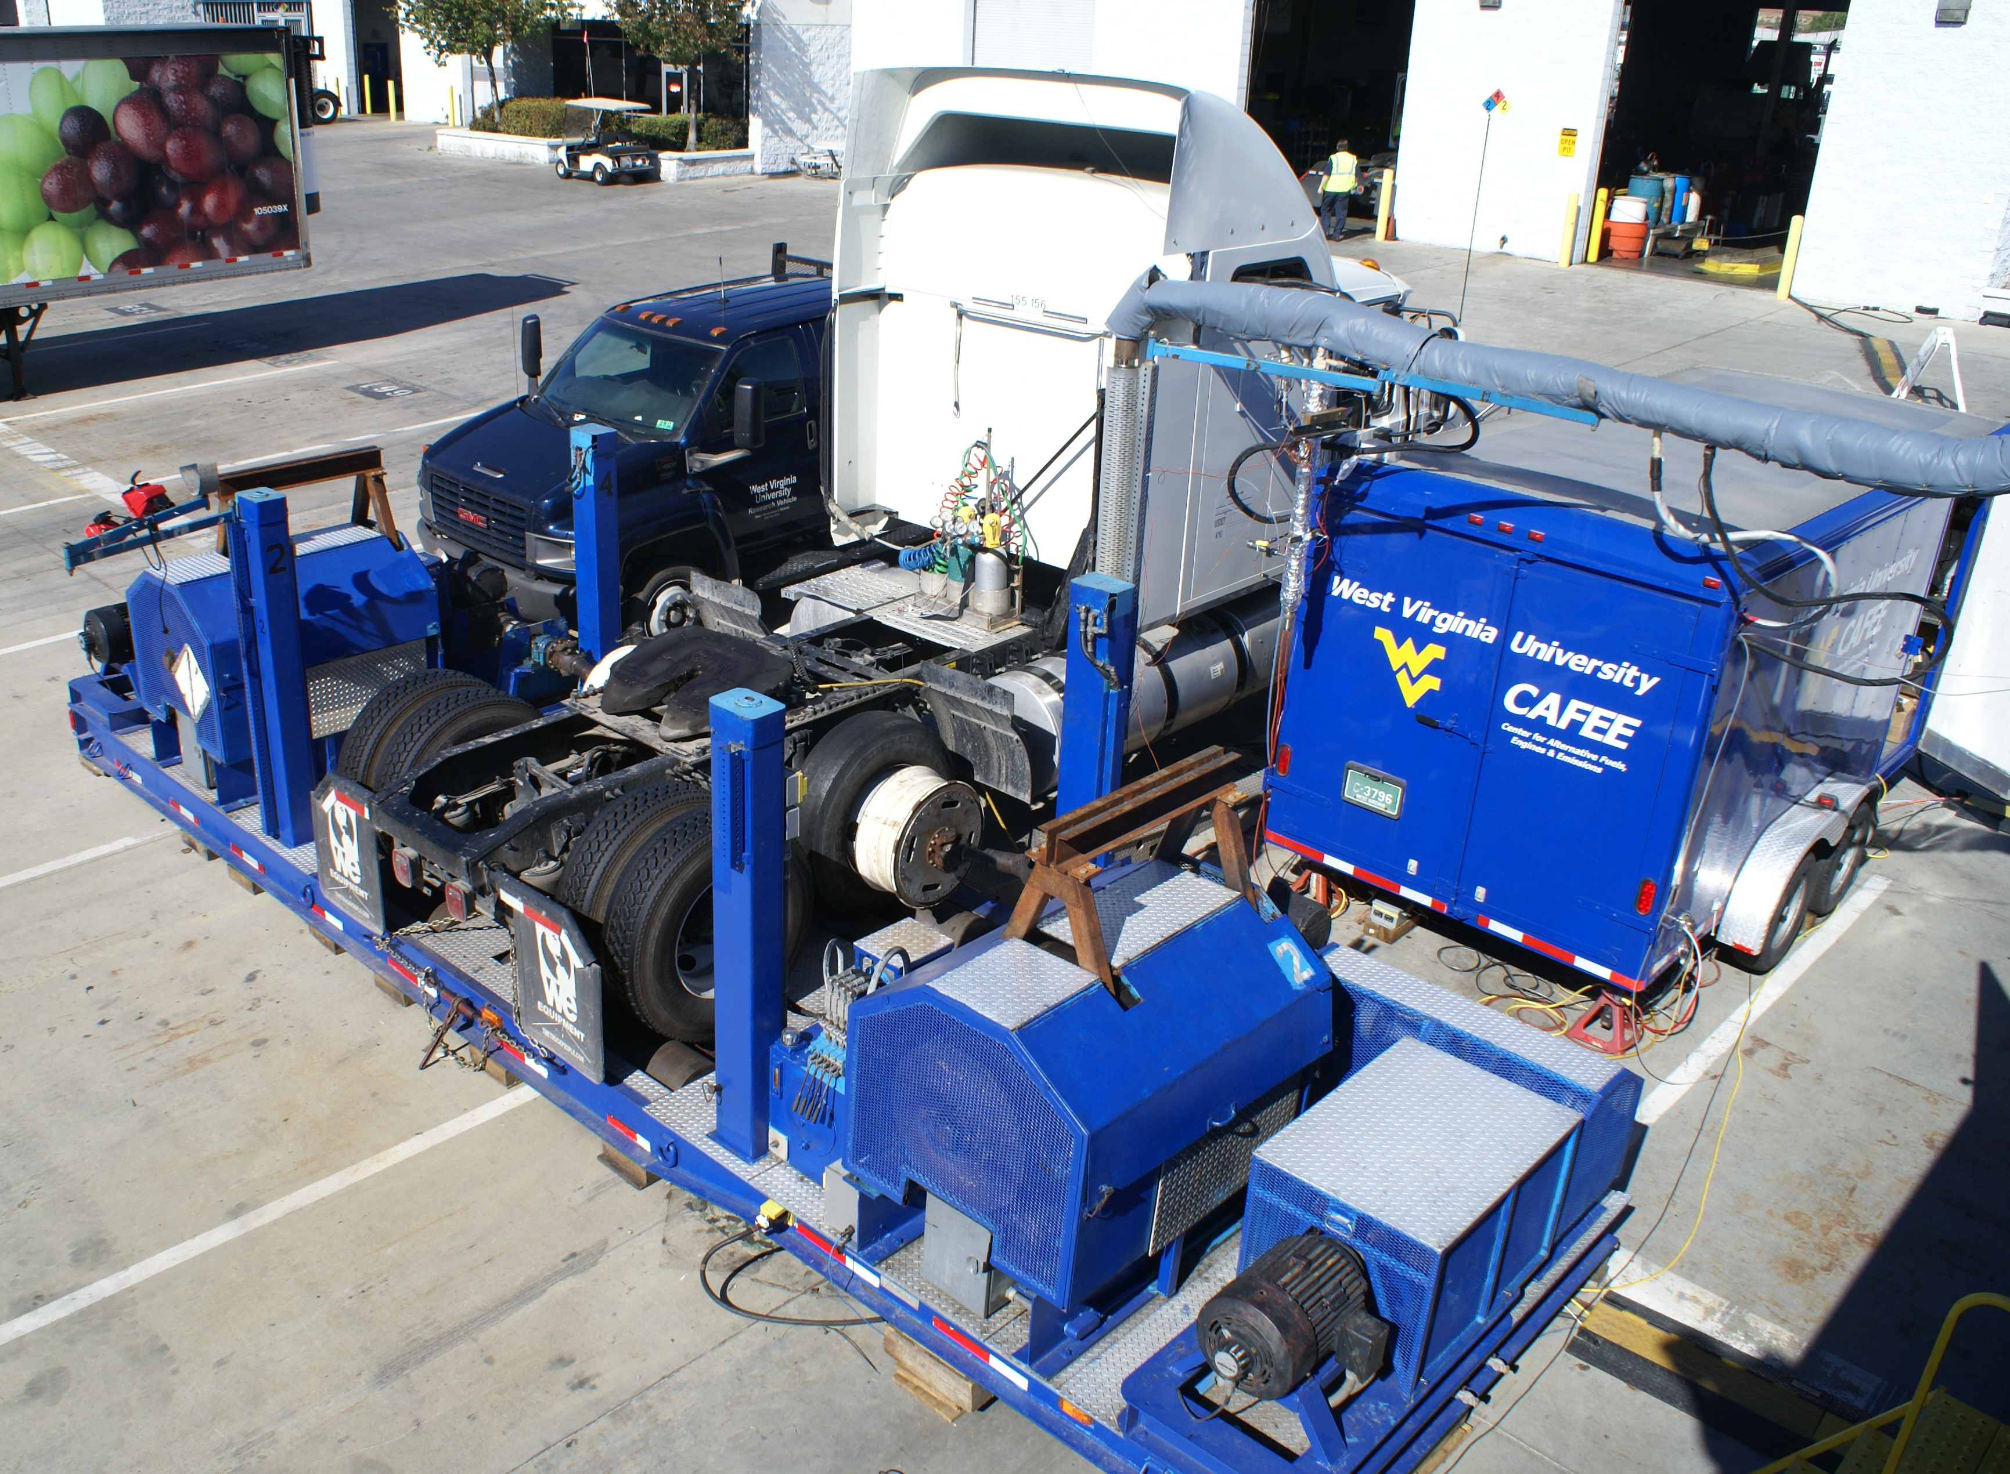
Center for Alternative Fuels, Engines and Emissions (CAFEE)
Benjamin M. Statler College of Engineering and Mineral Resources
Department of Mechanical and Aerospace Engineering (MAE)
Daniel Carder-Director CAFEE

Slide 2
CAFEE Vision Statement
West Virginia University’s Center for Alternative Fuels, Engines and Emissions (CAFEE) is committed to enhancing its worldwide leadership in the research and development of those environmentally responsible concepts and technologies necessary to provide sustainable transportation and power systems of the future. By 2020, the CAFEE will attain international prominence in the areas of transportation and power systems efficiency and environmental sustainability.

Slide 3
Mission Statement
WVU’s CAFEE will engage in leading-edge research and development of those technologies that will provide for sustainable transportation and power systems of the future. We will partner with industry, government, and academia and collaborate with international research organizations and universities to address technology barriers, while educating the engineers of tomorrow.

Slide 4
Center for Alternative Fuels, Engines and Emissions (CAFEE)
Established in 1989, to coordinate and stimulate research in the following areas:
Transportation Energy
Heavy-Duty Power Systems
Alternative Fuels
Research center operating within academic surroundings
Nearly $90 million in externally funded research
7 full-time Faculty, 5 full-time Engineers, 5 full-time technicians, and more than 30 Ph.D. and M.S. graduate students.
Funding Sources
Government
US Department of Energy
US Department of Transportation
US Department of Defense
California Air Resources Board
South Coast Air Quality Management District
Industry
Engine Manufacturers
Aftertreatment Manufacturers
Fuels/Additives Manufacturers
Research Organizations
Coordinating Research Council
Texas Environmental Research Consortium
Houston Advanced Research Center

Slide 5
CAFEE Research Areas
Fuels Research
Alternative Fuels, Additive Certification
Gas-to-Liquid and Solid-to-Liquid Fuels
Integration of Alternative Fuels for Transportation Systems
Engine and Combustion Research
Advanced Combustion Strategies for Alternative Fuels Utilization
Retrofit Development and Certification for Multi-Fuel Engine Applications
Fully Arbitrary Electronic Engine Control
Waste Heat Recovery
Exhaust Aftertreatment Research
Development, Performance, Verification/Certification
Vehicle Research
Transportation, Emissions Inventories, Hybrids, In-Use/NTE Testing, On & Off-Highway
In-use Emissions, Fuel Economy and Performance Monitoring for On- and Off-Highway Vehicles and Stationary Engines
Environmental Impact
Emissions Modeling, Secondary Atmospheric Effects, Real-world Emissions Assessment
Emissions Inventory Development

Slide 6
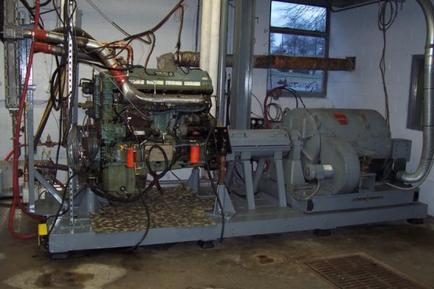
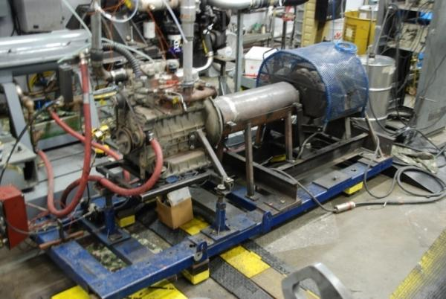
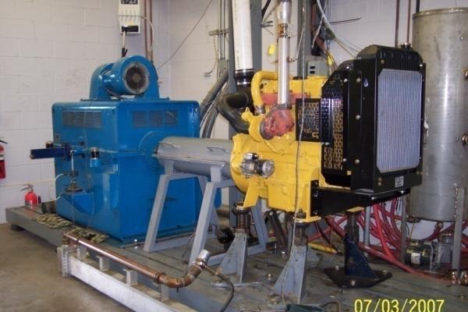
Engines & Emissions Research Laboratory (EERL)
GE 550hp DC Engine Dynamometer
100hp Eddy Current Dynamometer
GE 800hp DC Engine Dynamometer
Eaton 225hp AC Engine Dynamometer

Slide 7
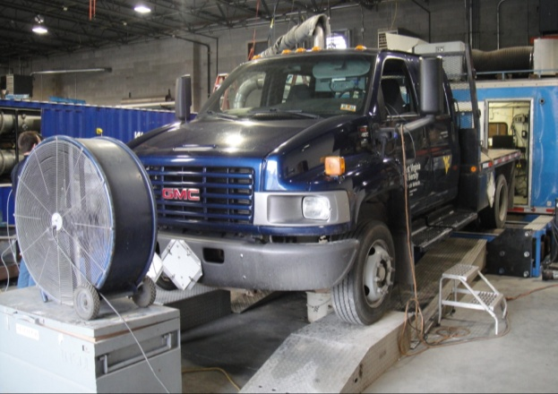
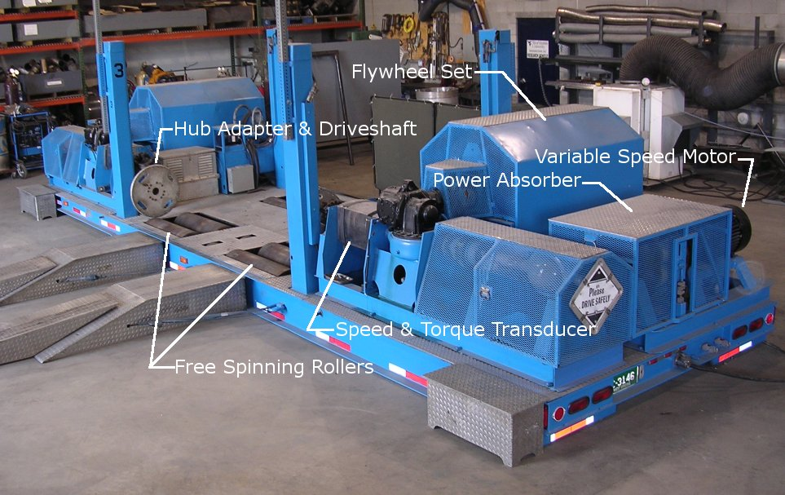
Transportable Emissions Measurement Systems
Transportable Heavy-duty Chassis Dynamometer
Transportable Emissions Measurement System (TEMS)
Medium-duty Chassis Dynamometer
Heavy-duty Chassis Dynamometer

Slide 8
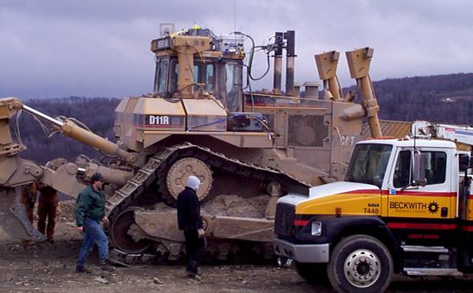
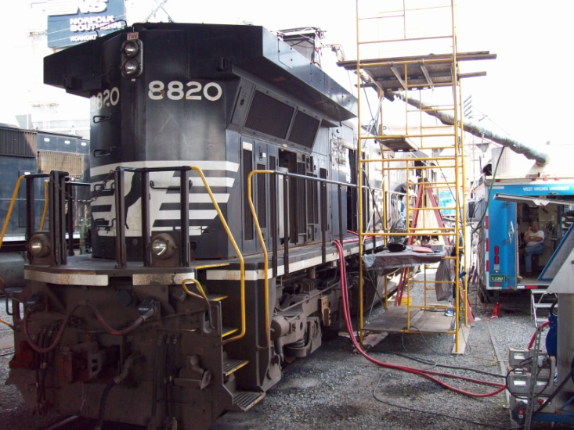
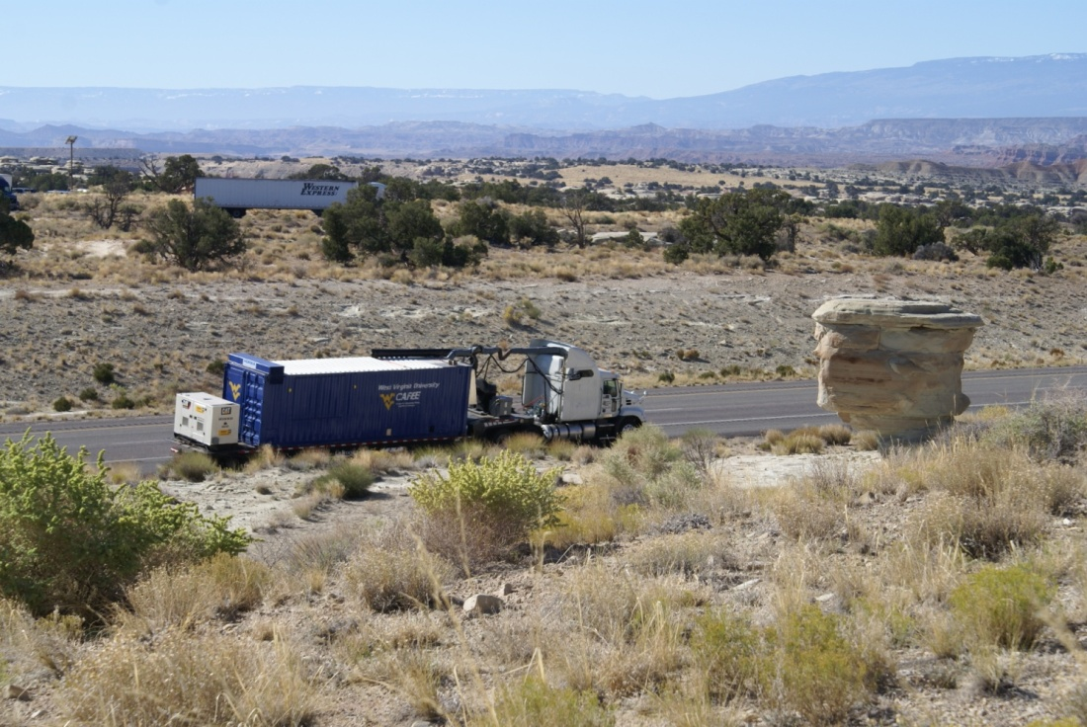
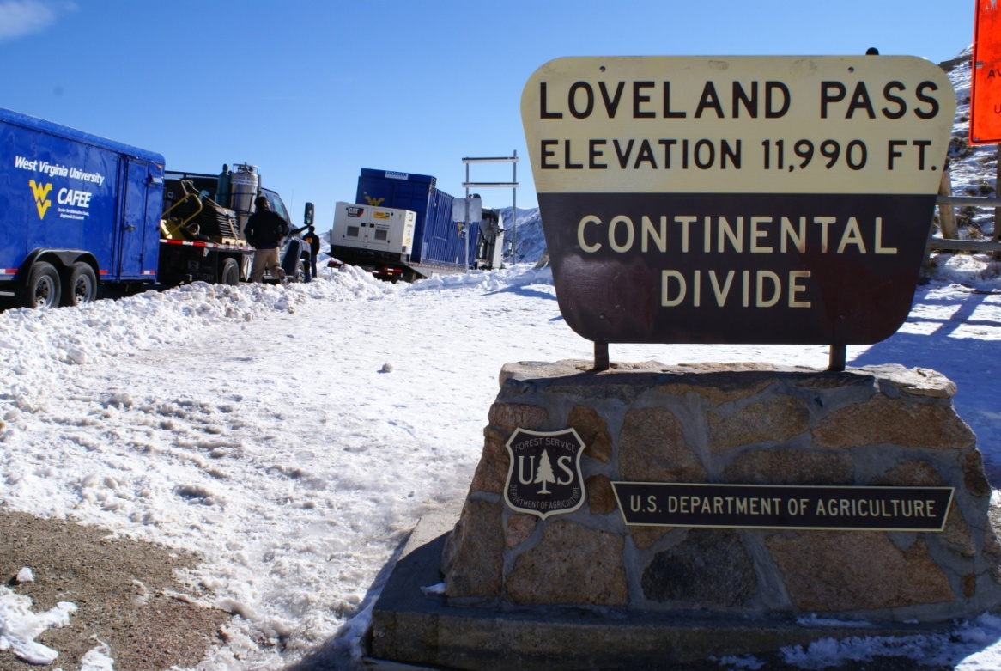
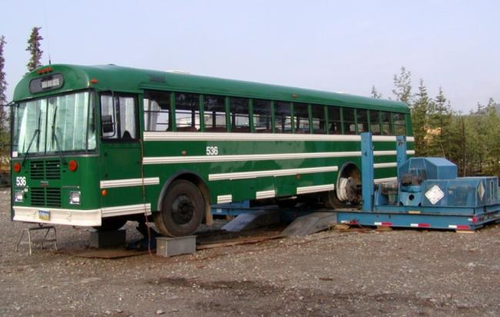

Slide 9
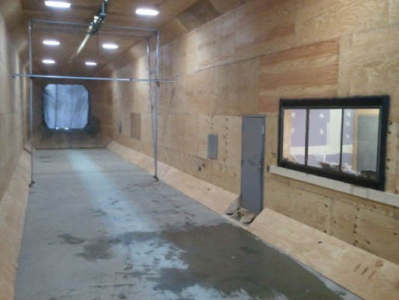
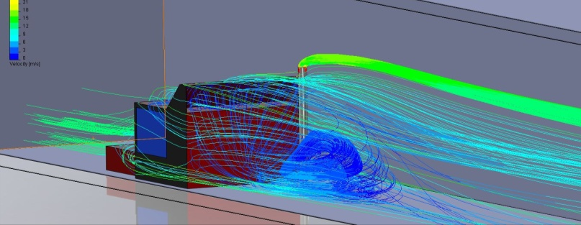
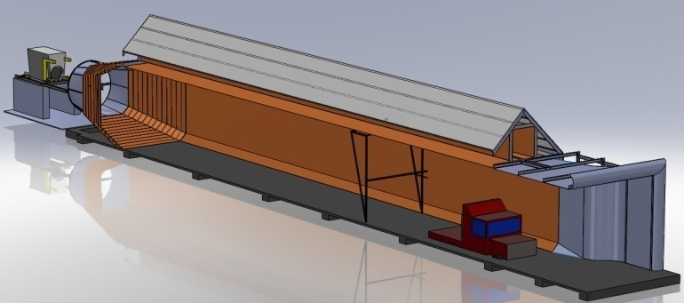
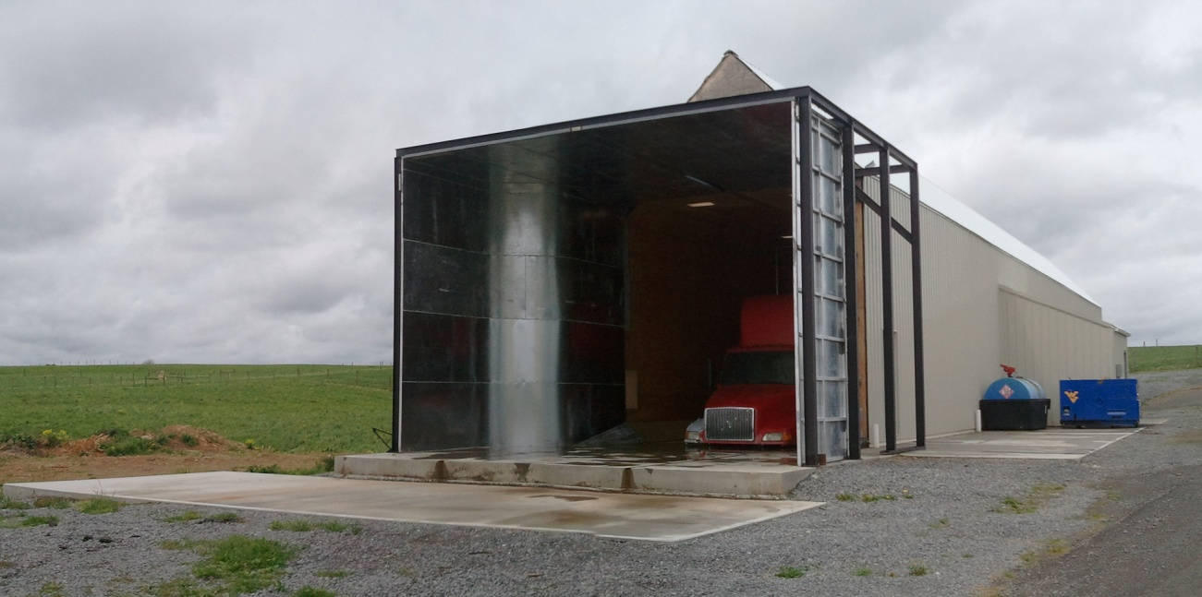
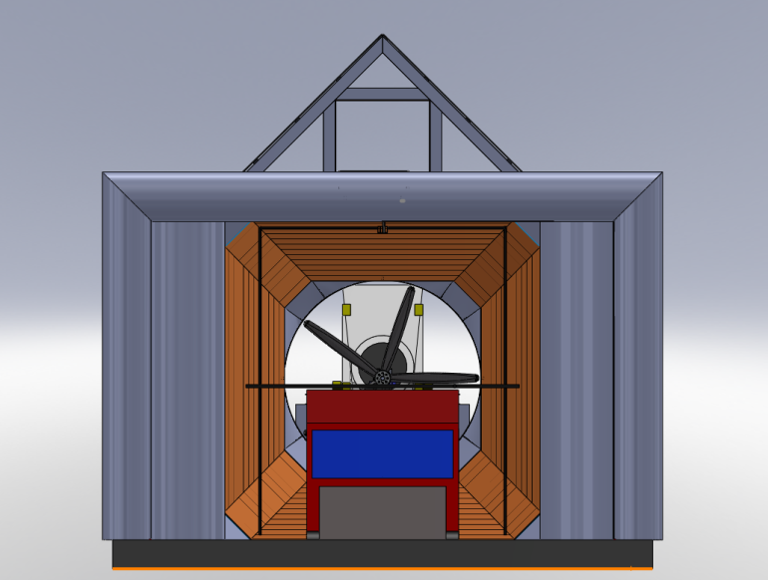
Subsonic Environmental Wind Tunnel
Analyze the interaction between exhaust and background PM
Further develop the knowledge of PM formation and evolution in real ambient conditions using current technologies
Investigate the secondary PM formation from latest exhaust after-treatment technologies (DPF/SCR)
Waste heat recovery research, exhaust after treatment cooling research
115ft
16ft
16ft

Slide 10
WVU CAFEE NATURAL GAS INITIATIVE
Natural gas Utilization
Advanced internal combustion engine concept: Low temperature combustion (LTC), Reactivity Controlled Compression Ignition (RCCI), dual-fuel combustion
Development of EPA compliant dual-fuel retrofit kits (FYDA Energy Solutions)
Laser based ignition for internal combustion engines
Plasma ignition for internal combustion engines
Emissions mitigation
Lean burn methane catalyst (Hyper-Cat LLC)
Crankcase methane emission
Emissions monitoring
Fugitive emissions from shale gas drilling activity (NETL DOE)
Tailpipe emissions of regulated pollutants from natural gas vehicles ( South Coast Air Quality Management District, Environmental Defense Fund)
Ammonia and greenhouse gas emissions from stoichiometric natural gas engines
Lubrication oil emissions from natural gas engines
Natural gas derived fuels
Di-methyl ether (DME)
High alcohol fuels

Slide 11
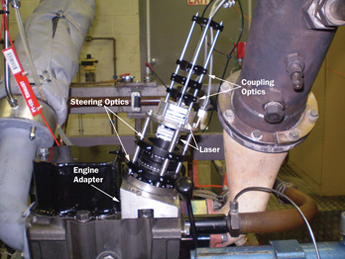
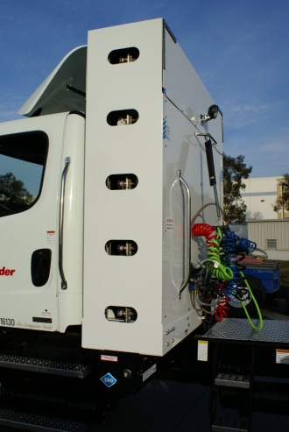
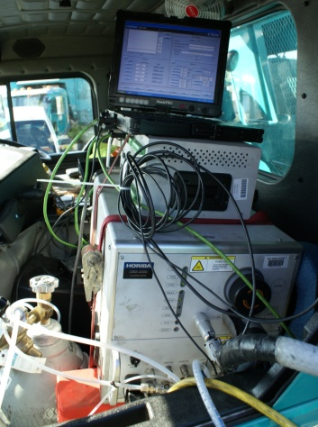
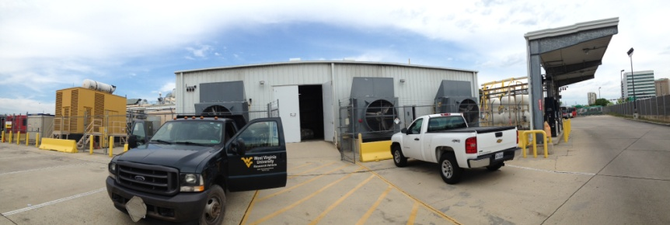
RECENT NATURAL GAS RESEARCH PROJECTS
Quantification of Perturbation Effects on an Alternative Ignition System
The CAFEE, in conjunction with NETL and NIOSH, is working to determine the effects thermal and oscillatory perturbations.
Assessing Fugitive Methane Emissions Impact Using Natural Gas Engines in Unconventional Resource Development
NETL DOE funded study is aimed at characterizing the impacts of fugitive methane emissions from dual-fuel and dedicated natural gas engines that can replace diesel powered units currently dominating the unconventional resource development operation.
Pump-to-Wheels Natural Gas Emissions from the Heavy-Duty Trucking Sector
Study funded by EDF to quantify the fugitive methane emissions arising due to the use of natural gas in the transportation sector; including extraction, transportation (pipeline), conditioning at fueling stations, storage and use on HD vehicles.

Slide 12
UPCOMING NATURAL GAS RESEARCH PROJECTS
Di-Methyl Ether (DME)
A promising low carbon alternative fuel that can be derived from natural gas and bio mass
Fuel properties suitable for compression ignition with low soot emissions
Research will be aimed at studying fundamental combustion characteristics of DME using a single cylinder research engine
Development of control systems and fuel injection systems for conversion of diesel fuel system to DME in heavy-duty applications
Research of advanced combustion concepts such as RCCI using DME and natural gas engine as dual-fuel.
Development of lean methane catalyst
WVU and Hyper-Cat will jointly work towards developing catalyst formulation aimed at low temperature light-off for methane.
Development of Ammonia reduction system for dedicated stoichiometric NG engines
Ammonia production from three-way catalyst has been identified as significant shortcoming in stoichiometric natural gas engines.
The upcoming study funded by SCAQMD will be aimed at developing a passive selective catalyst reduction (SCR) system to simultaneously mitigate ammonia and oxides of nitrogen emissions.

